Slide 1
Redesigned presentation
By Ariane Tiomou
Source:
TransformingDarden RestaurantsSeptember 11, 2014 (Starboard Value)

Slide 2
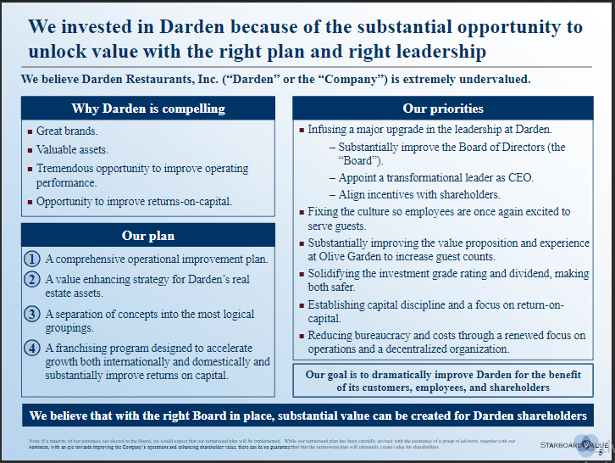

Slide 3
We invested in Darden because of the substantial opportunity to unlock value with the right plan and right leadership
Our goal is to dramatically improve Darden for the benefit of its customers, employees, and shareholders
Why Darden is compelling
Our priorities
Great brands, valuable assets
Tremendous opportunity to improve operating performance and returns-on-capital
Fixing the culture so employees are once again excited to serve guests.
Infusing a major upgrade in the leadership at Darden
Substantially improving the value proposition and experience at Olive Garden to increase guest counts.
Solidifying the investment grade rating and dividend, making both safer.
Establishing capital discipline and a focus on return-on-capital.
Reducing bureaucracy and costs through a renewed focus on operations and a decentralized organization
Our plan
A comprehensive operational improvement plan.
A value enhancing strategy for Darden’s real estate assets.
A separation of concepts into the most logical groupings.

Slide 4
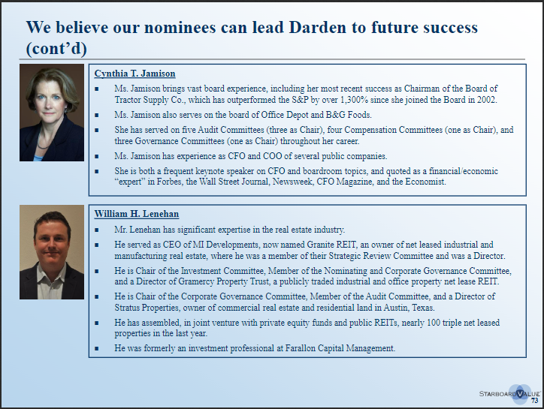

Slide 5
We believe our nominees can lead Darden to future success (cont’d)
Ms. Jamison brings vast board experience, including her most recent success as Chairman of the Board of Tractor Supply Co., which has outperformed the S&P by over 1,300% since she joined the Board in 2002.
Ms. Jamison also serves on the board of Office Depot and B&G Foods.
She has served on five Audit Committees (three as Chair), four Compensation Committees (one as Chair), and three Governance Committees (one as Chair) throughout her career.
Ms. Jamison has experience as CFO and COO of several public companies.
She is both a frequent keynote speaker on CFO and boardroom topics, and quoted as a financial/economic “expert” in Forbes, the Wall Street Journal, Newsweek, CFO Magazine, and the Economist
Cynthia
T. Jamison
Mr. Lenehan has significant expertise in the real estate industry.
He served as CEO of MI Developments, now named Granite REIT, an owner of net leased industrial and manufacturing real estate, where he was a member of their Strategic Review Committee and was a Director.
He is Chair of the Investment Committee, Member of the Nominating and Corporate Governance Committee, and a Director of Gramercy Property Trust, a publicly traded industrial and office property net lease REIT.
He is Chair of the Corporate Governance Committee, Member of the Audit Committee, and a Director of Stratus Properties, owner of commercial real estate and residential land in Austin, Texas.
He has assembled, in joint venture with private equity funds and public REITs, nearly 100 triple net leased properties in the last year.
He was formerly an investment professional at Farallon Capital Management
William
H. Lenehan

Slide 6
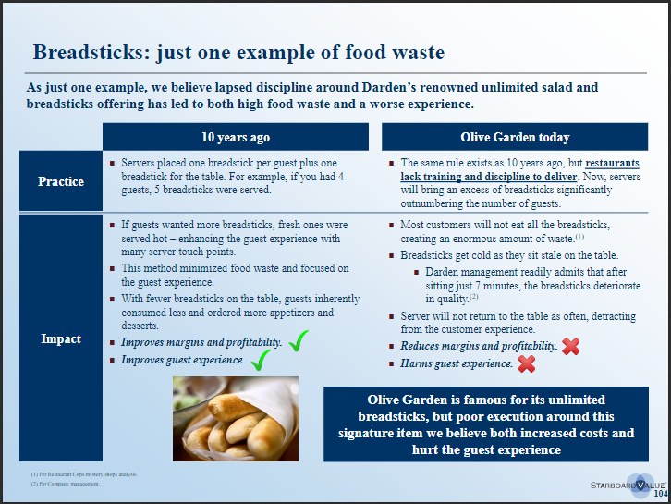

Slide 7


Breadsticks: just one example of food waste
10 years ago
Olive Garden today
Servers placed one breadstick per guest plus one breadstick for the table. For example, if you had 4 guests, 5 breadsticks were served
The same rule exists as 10 years ago, but restaurants lack training and discipline to deliver. Now, servers will bring an excess of breadsticks significantly outnumbering the number of guests,
Practice
Impact
If guests wanted more breadsticks, fresh ones were served hot –enhancing the guest experience with many server touch points.
This method minimized food waste and focused on the guest experience.
With fewer breadsticks on the table, guests inherently consumed less and ordered more appetizers and desserts.
Most customers will not eat all the breadsticks, creating an enormous amount of waste.(1)
Breadsticks get cold as they sit stale on the table.
Darden management readily admits that after sitting just 7 minutes, the breadsticks deteriorate in quality.(2)
Server will not return to the table as often, detracting from the customer experience
Key takeaway
Improves margins and profitability.
Improves guest experience.
Reduces margins and profitability.
Harms guest experience

